Slide 1

Exam Preparation
How to APPROACH EXAMS EFFECTIVELY AND manage stress

Slide 2

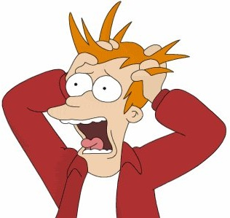
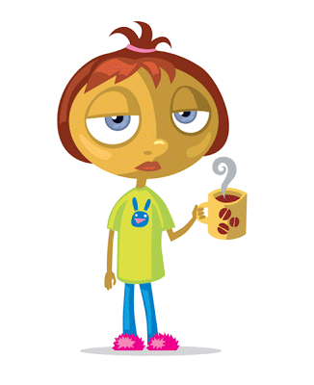
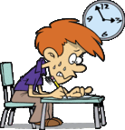
What comes to mind when you think about exams?
https://www.youtube.com/watch?v=hlvZ_8V6uc4

Slide 3
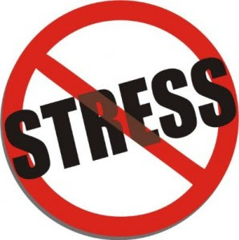
TAKE CARE OF YOURSELF
Exam time can feel like a stressful time so it is really important that you use strategies that can help you to overcome feelings of stress and anxiety. Most of you will begin to prepare for exams over the break so establishing new habits now will help you feel confident when exam week arrives.
Begin by keeping well over the Holidays...

Slide 4
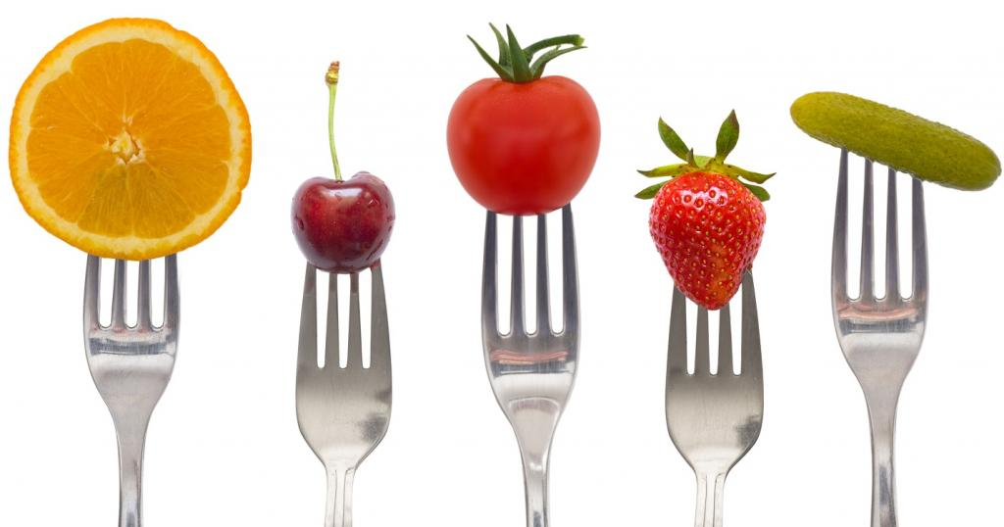
Maintain a well-balanced diet
During the break (and even when its not the break!) it can be difficult to eat healthy, nourishing meals – especially if you're at social gatherings. However, if you don’t fuel your body with food that is nourishing, it can cause you to experience things like anxiety or fatigue.
Try to be mindful of what you eat, and try to eat healthy most of the time. That doesn’t mean you can’t treat yourself once in a while - after all, we can all use a few treats here and there :)

Slide 5

Follow your regular sleep routine… or create a healthy sleep routine if you don’t have one!
When we are on holidays, we have the tendency to stay up later than usual and sleep in much more than we usually do. This can confuse the body and interfere with the sleep cycle. (and that can make it really difficult to transition smoothly back into a regular routine AFTER the holidays).

Slide 6
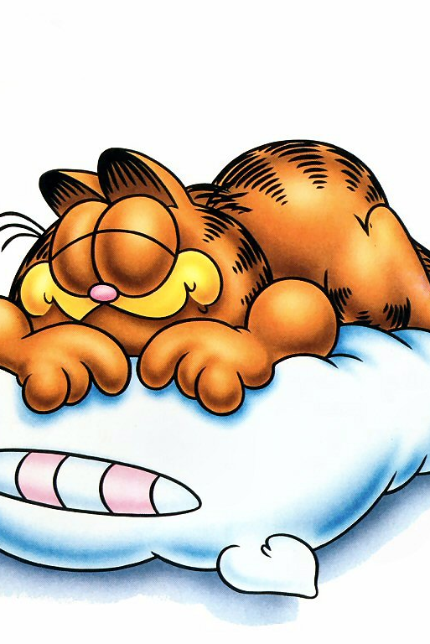
During the holiday, it’s important to keep a regular sleep routine, similar to the one you followed before the break. OR, if you didn’t have good sleep habits before, this is a good time to create a new, healthy routine:
      Go to bed and wake up at a usual time, and get close to the same hours of sleep each night. Too little sleep can interfere with our ability to concentrate, while getting too much sleep can make you feel more tired.
      Avoid electronics an hour before bedtime.
      Study at a desk, not on your bed.
This Photo by Unknown Author is licensed under CC BY-NC-ND

Slide 7


Find time for exercise
Making time for exercise can be difficult, especially during the holidays; however, it is crucial for maintaining a healthy body and mind.
Simply taking 20 minutes in a day to go for a walk or complete a yoga video can have a significant impact. Although it can be a pain to exercise, it will make you feel energized and satisfied afterwards.
Consider trying out for a sports team, getting involved in an intramural or joining the strength training club here at SJA to kick start a healthy new routine!

Slide 8
Make plans, set schedules and get organized
Keep a regular routine - Most people find that having a regular routine or schedule can help keep them stay organized and less anxious.
Stay organized - Set daily goals of what you need to get done each day based on its rank of priority. Break the tasks into chunks, rather than trying to get through everything all at once.
Example: CHUNKING / Studying in short intervals. Three 40 minute periods with breaks is better than 2 hours straight.

Slide 9
Make plans, set schedules and get organized… continued.
Try to aim to complete only a few goals each day, and then think about whether or not they are realistic to meet considering your daily routine and work schedule for the day.
Use the exam preparation calendar provided by your Student Success Teacher – try to follow it, or create one that works with your schedule – and stick to it.
Remember to keep the goals simple, and ask for help if it's too much for you to handle on your own. Seek support if you need it – don’t ignore your feelings.

Slide 10



HOW DO YOU STUDY?
Think about which study strategies have worked well for you in the past … and which ones have not. Use the planner provided by your SST to try out some new strategies for the next test or quiz you are going to write (just don’t leave it until the night before!). Then, use the ones that work to study for your exams.
Establish a focused atmosphere: ELIMINATE DISTRACTIONS.
Turn off your phone, tv, computer, etc.

Slide 11

RELAX & ENJOY
Take time for yourself - In order to take care of others, you need to take of yourself first. In other words, you need to take time for yourself to relax and rejuvenate. For example, do an activity that makes you feel happy, such as shopping, sewing, or baking, or a calming activity such as mindfulness, yoga, or running.
Have fun! - The holidays are meant to be a joyous time of year, regardless of the anxiety and stress that it can cause. Enjoy the moments you spend with your friends and family, and have a blast while you are with them.

Slide 12
If you have any questions or need extra support:
Ask your teachers for tips in their area of expertise
Come to the Room 141 (student achievement room) or Room 131 (academic resource IEP) during your lunch period as often as you like to get help with getting organized, study strategies, help getting caught up in your classes.
Grade 9 Lunch- come to Room 141
Mon/Wed-P.D’Amico-Numeracy
Tue/Thurs-L.O’Donnell-Literacy
Talk to your Guidance Counsellor and / or Student Success Teacher.

Slide 13
EXAM SCHEDULE:
ST. JOAN OF ARC CATHOLIC SECONDARY SCHOOL
EXAMINATION SCHEDULE
SEMESTER 1 – JANUARY 2018
TIME | WED. JAN 23 | THUR. JAN. 24 | FRI. JAN. 25 | MON. JAN. 28 | TUE. JAN. 29
8:27am – Be in class 9:00 - 10:30am – Write exams. Students are not to be released before the end of the exam time. | PERIOD 1 COURSE EXAMS | PERIOD 2 COURSE EXAMS | PERIOD 3 COURSE EXAMS | PERIOD 4 COURSE EXAMS | SNOW DAY (IF REQUIRED)
10:30am - 2:20pm | Home to study | Home to study | Home to study | Home to study

Slide 14
Important Information for Students
you must be in full uniform
if you miss an exam for any reason, the attendance office must be notified; illness must be accompanied by a medical note; emergencies must be accompanied by a phone call and a legitimate note must follow
lockers may not be accessed during exam times; students must stay out of the hallways during all scheduled exam times
it is your responsibility to arrive on time, be prepared, and to be in the right place for your exam
if you do not have a class in the period being examined, you do not have to be at school
after each exam, you are asked to leave the building unless you have a scheduled appointment with a teacher; if there are extenuating circumstances, please see your VP.
if you are here for extra help on a non-exam day, you must be in uniform
all texts must be returned on/before the day of the exam

Slide 15

Happy Holidays, everyone! Remember - your physical and psychological wellness is the most important and valuable thing you have, and YOU deserve to give yourself care and attention.

